Slide 1
Intro To Machine Learning
Beginner Track: Workshop #1
Slides Link: https://tinyurl.com/aibeginner1
Member Portal Attendance Code: aibegin

Slide 2
Please Sign In Here

Slide 3
Overview of ACM AI

Slide 4
ACM AI Overview
Goal is to develop and foster a community of students who are interested in Machine Learning and Artificial Intelligence
Hold weekly workshops to teach basic concepts of ML through presentations and interactive code examples for people of all backgrounds and skill levels

Slide 5
Beginner And Advanced Tracks
Workshops in the past were too quick, covered too much, or weren’t engaging enough
There were others who were already familiar with the topics being taught
We’ve created two tracks: Beginner and Advanced
Beginner track requires no prior knowledge. Anyone interested can join!
Advanced Track expects knowledge of basic ML concepts and experience with programming in Python

Slide 6
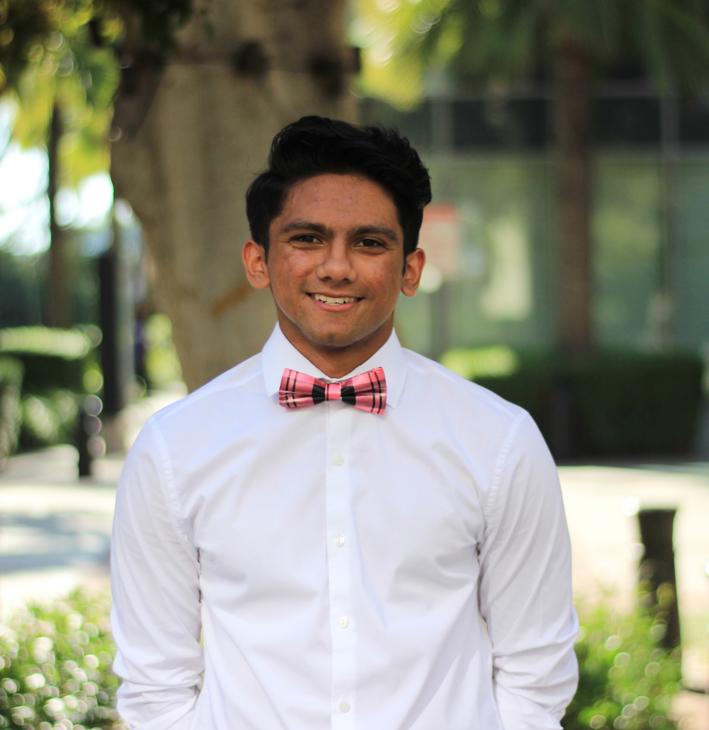

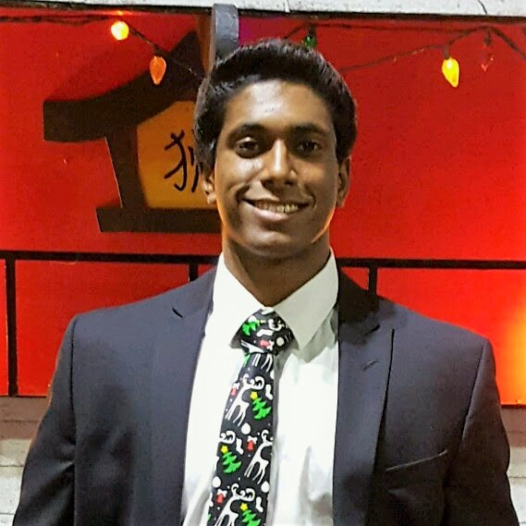

Officers
Adit Deshpande
President
Parth Ingle
Officer
Aaron Philip
Intern
Megha Ilango
Intern

Slide 7
Community
Lots of online tutorials and courses on machine learning
Learning ML without a community and support system is difficult
That’s where we come in
Workshops will allow you to learn from each other as well as from us
Opportunity to learn as well as to ask questions
Get to know your officers and your peers

Slide 8
Beginner Track Schedule
Week | Workshop
Week 2 | Introduction to Machine Learning
Week 3 | Introduction to Linear Regression
Week 4 | Linear Regression Hack Session
Week 5 | Introduction to Logistic Regression
Week 6 | Logistic Regression Hack Session
Week 7 | Introduction to Neural Networks
Week 8 | Neural Networks (cont.)
Week 9 | Neural Networks Demonstration

Slide 9
Getting to Know Each Other
Get into groups of 3 - 4 (5 is okay too)
Spend 1 minute introducing yourself (name, year, comic book villain superpower)
Activity: Find one thing that everyone in your group has in common. The trick is that it has to be something that no other group would have in common
Ex) “We all like pizza” wouldn’t work because there is likely going to be another group where that is common as well
Hint: Think hobbies, experiences, interests, movies, TV shows ...

Slide 10
We Get It. Learning Machine Learning is Tough.

Slide 11
Obstacles to Learning ML
ML is exciting right now, but the path to learning about it isn’t straightforward
Can be easy to get caught up in all the technical terms and complex math
Difficult to understand high level idea without getting lost in the details

Slide 12
Our Goal
Beginner Track series will help you all:
Understand technology that is changing our lives today
Have interesting discussions
Have fun throughout the whole process.
By the end of this workshop series, you will have:
A solid foundation in conceptual machine learning knowledge
Seen and implemented ML algorithms in code
Feel comfortable learning more advanced concepts in the future

Slide 13
Remember
We don’t want this to be just another workshop you attend once a quarter.
We don’t want this to be us lecturing at you for 90 minutes.
We don’t want this to feel like class.
We want you to enjoy the process of learning.
We want you to feel comfortable asking questions and talking with others.
We want you to have fun.

Slide 14
What’s So Cool About It Anyway?

Slide 15
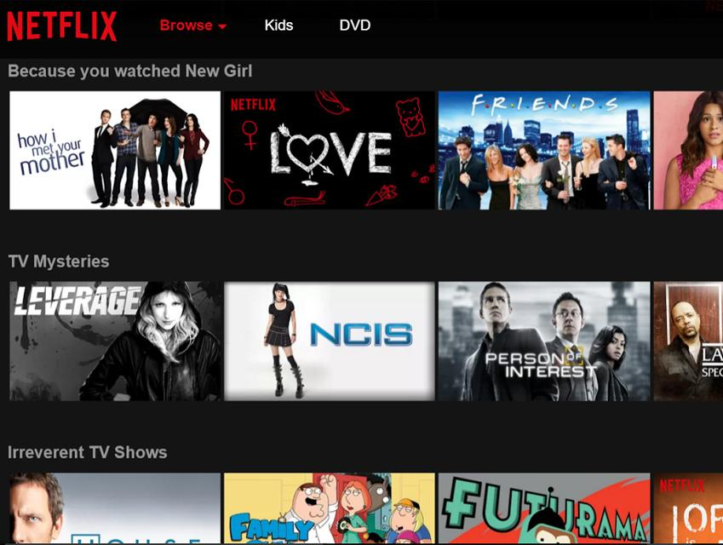
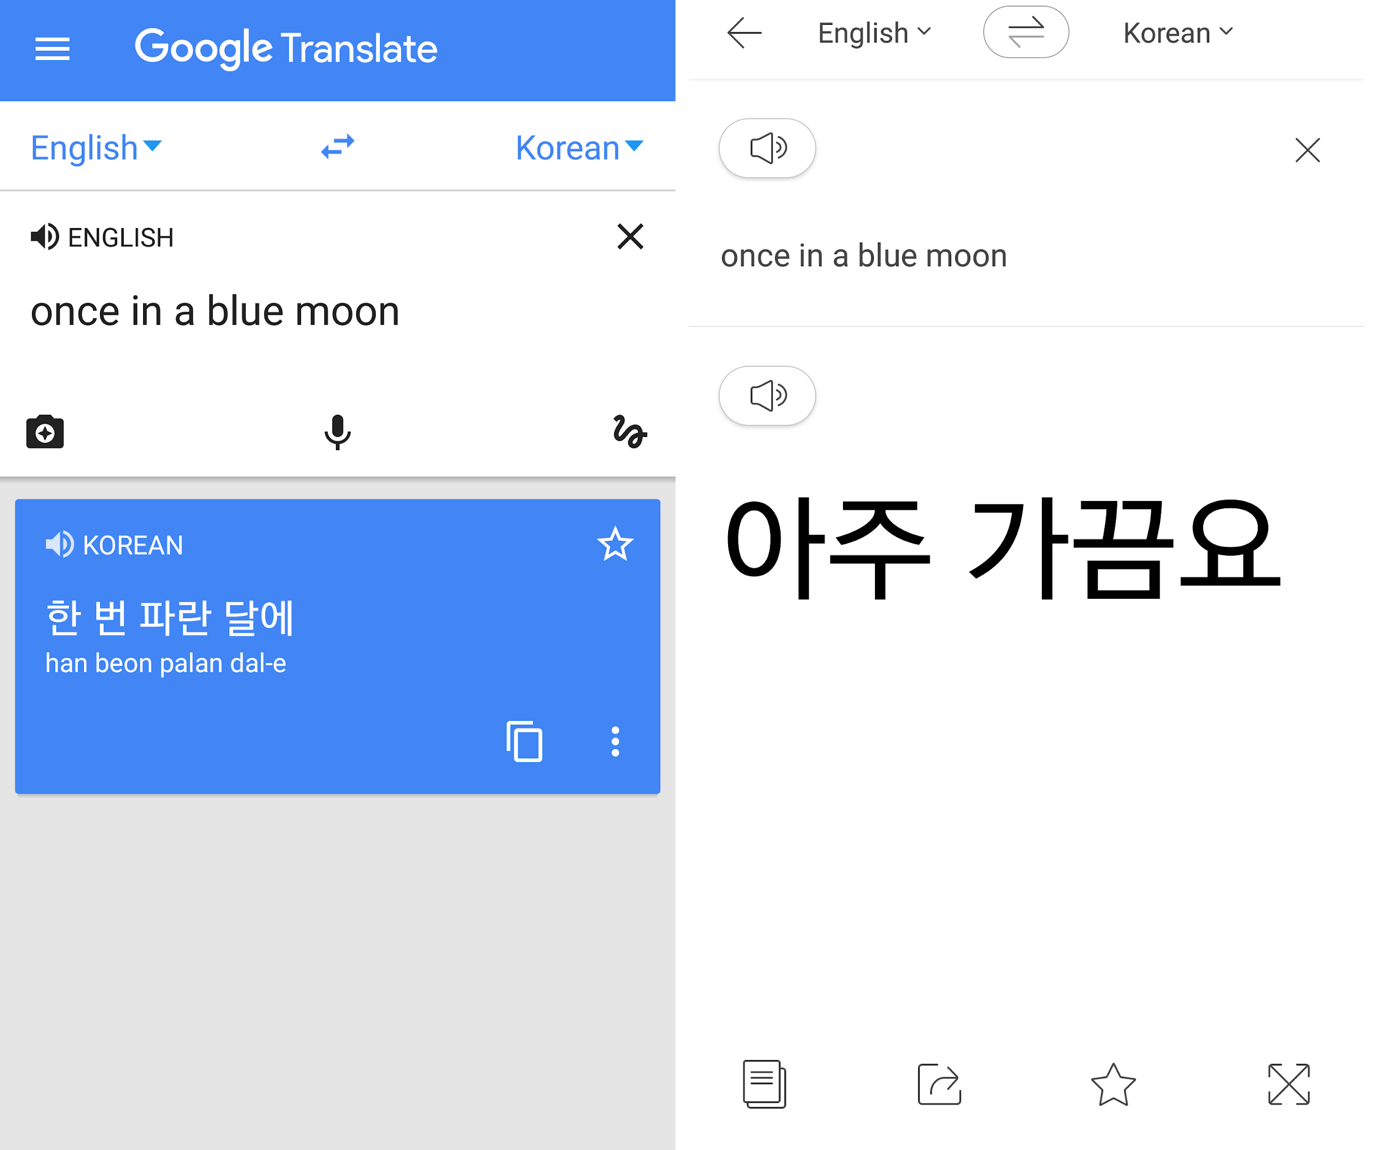
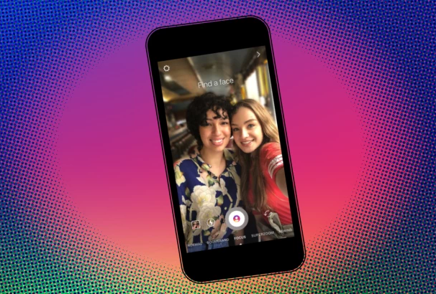
Machine Learning is Everywhere
Netflix Recommendations
Google Translate
Instagram Focus

Slide 16
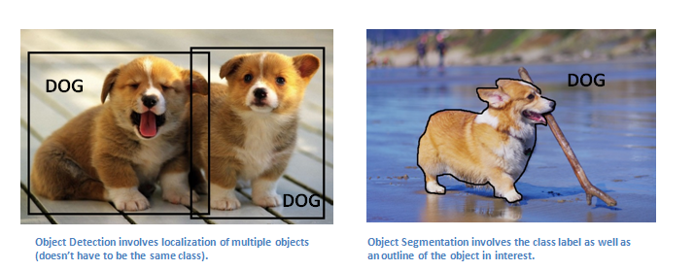
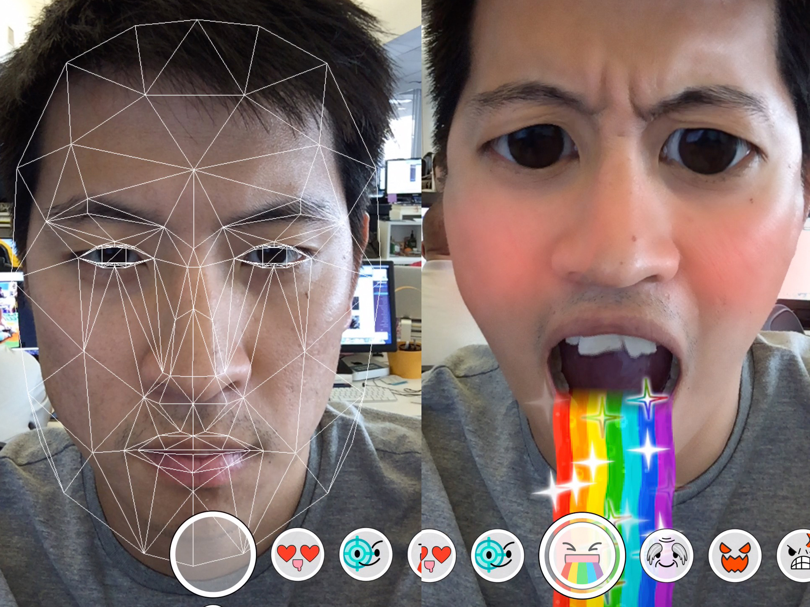
Machine Learning can be used for ...
Computer Vision
Convolutional neural networks attain the best performance on computer vision tasks.

Slide 17
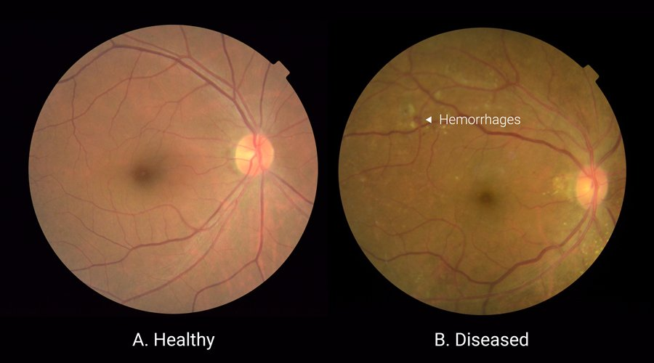
Machine Learning can be used for ...
Healthcare
Deep Learning techniques outperform trained specialists in some medical recognition tasks.

Slide 18

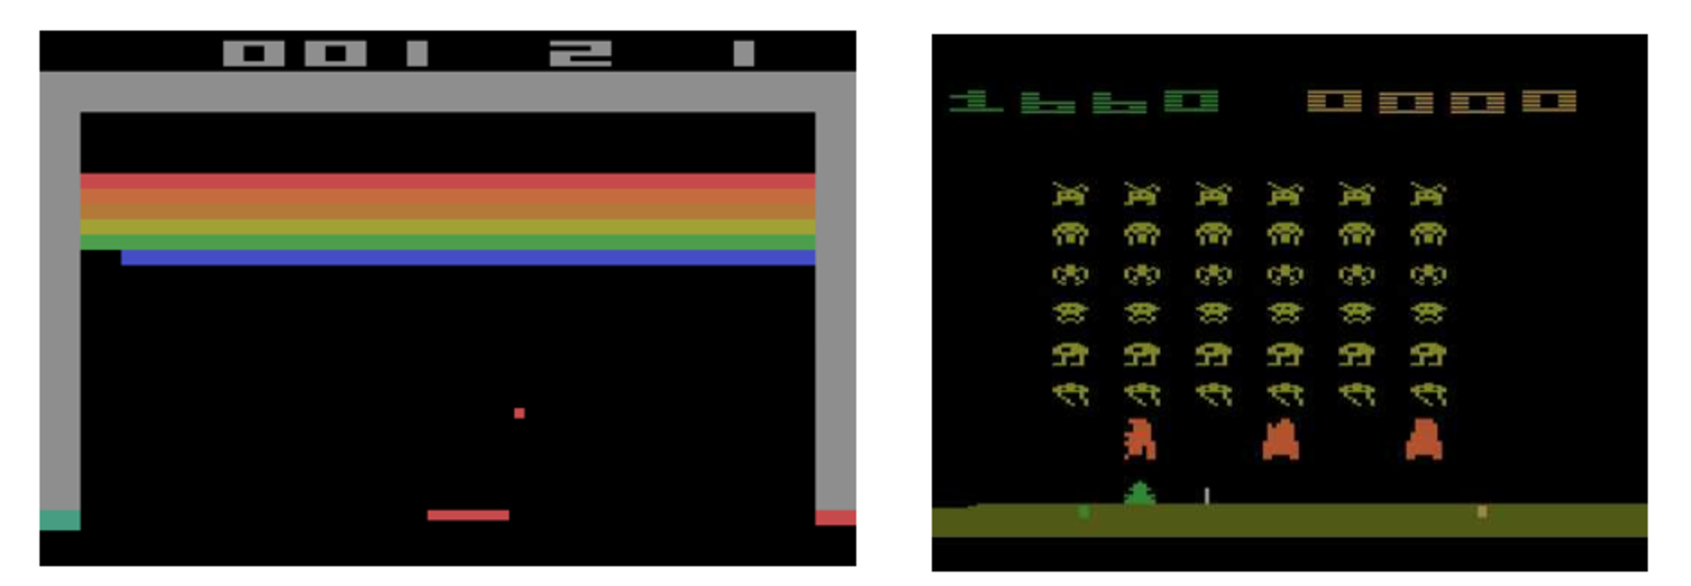
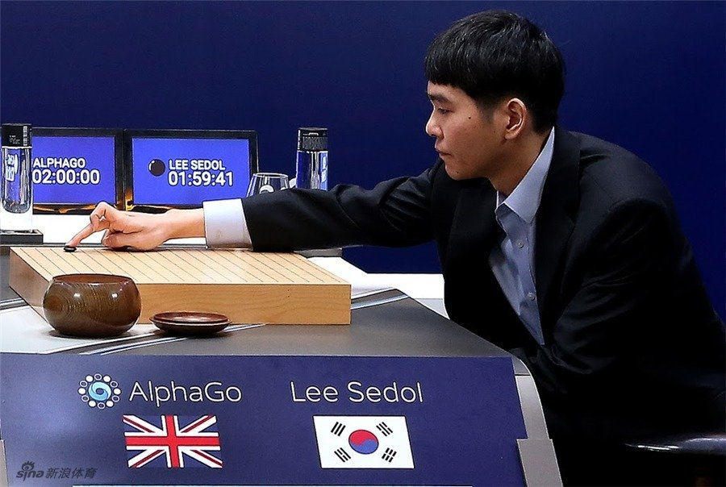
Machine Learning can be used for ...
Games
Reinforcement learning attains the best performance on complex games.

Slide 19

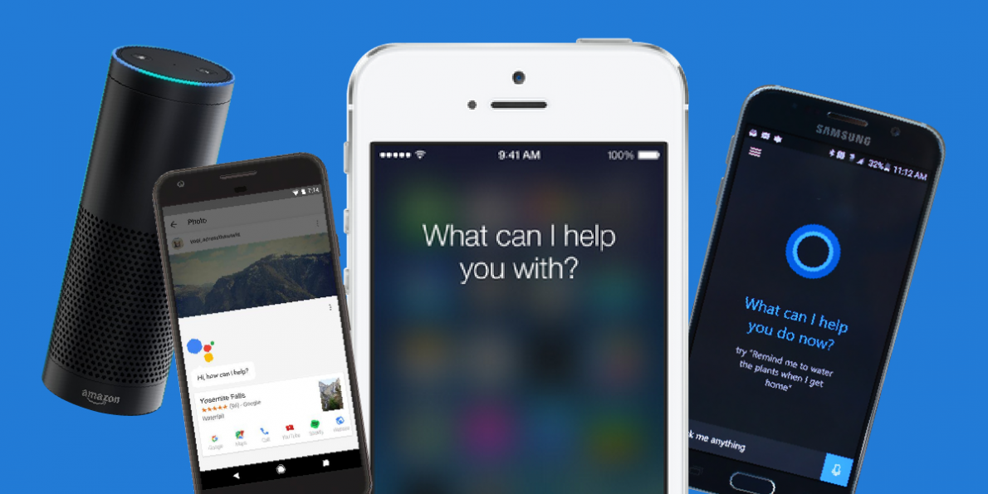
39
Machine Learning can be used for ...
Natural Language Processing
Recurrent Neural Networks attain the best performance on language translation tasks.

Slide 20
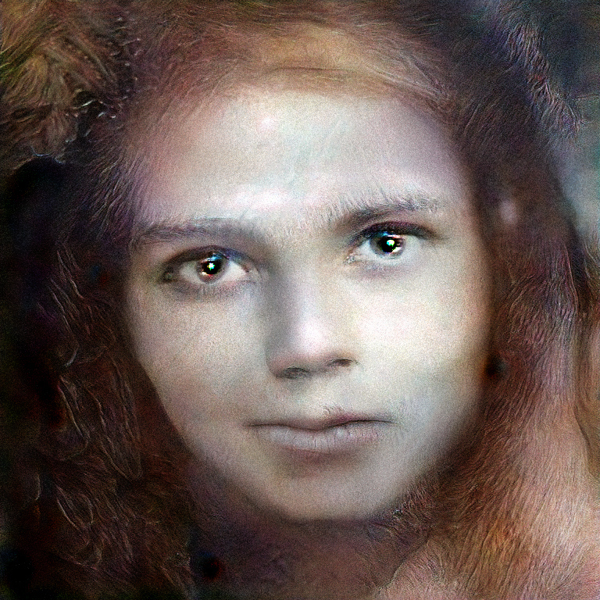
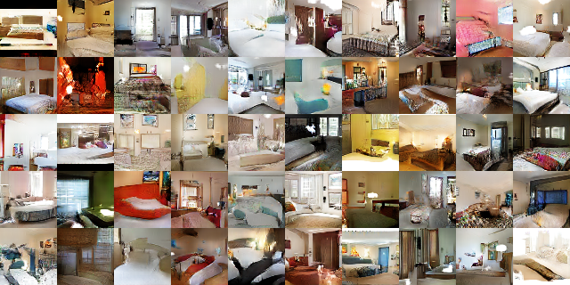
Machine Learning can be used for ...
Art
Generative adversarial networks create synthetic images that appear realistic.

Slide 21

The last 10 years have been about building a world that is mobile-first. In the next 10 years, we will shift to a world that is AI first.
- Sundar Pichai, CEO of Google

Slide 22
What’s your take?
In your groups, come up with a cool application of machine learning (it can be as ridiculous or realistic as you want)
You can use one of the categories we talked about for inspiration or come up with your own
We’ll ask a few groups to pitch their idea (for candy)

Slide 23
So, What Is Machine Learning Exactly?

Slide 24
Computer Science: Some Popular Topics
Web Dev
Mobile Dev
AI
Machine Learning
Deep Learning

Slide 25
Definitions
Artificial Intelligence - The theory and development of computer systems able to perform tasks that normally require human intelligence, such as visual perception, decision-making, and translation between languages.
Machine Learning - A type of AI that provides computers with the ability to learn without being explicitly programmed.

Slide 26
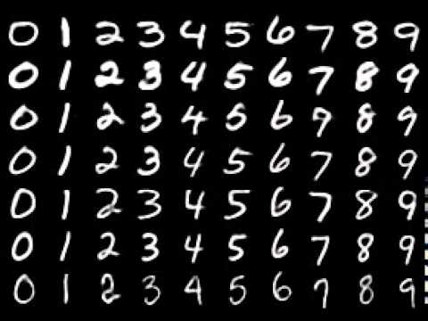
Intuitive Example
Imagine that you wanted to create a program that could identify handwritten digits like these.

Slide 27
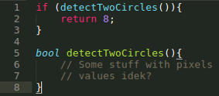

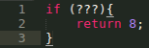

Intuitive Example
You could write a function to detect circles, another one to identify diagonal lines, and other functions to detect more features.
This was the classical approach to creating intelligent systems.

Slide 28
Intuitive Example
Sounds pretty tedious and complicated, right?
Instead let’s see if the computer can learn how to identify digits.

Slide 29
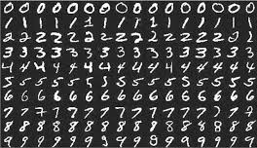
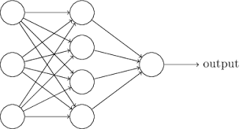
Intuitive Example
Show the computer a lot of expected inputs and outputs.
Then the computer learns a representation that maps inputs to outputs.
Inputs:
input
Outputs:
0 0 0 . . .
1 1 1 . . .
2 2 2 . . .
. . .
. . .
. . .

Slide 30
How does machine learning work?

Slide 31
ML Pipeline
Input data
Learning
Interpretation
This can be in the form of a text file, spreadsheet, etc.
Represent the data using an algorithm
Learning
Evaluate your data representation
Gain insight from data

Slide 32
With more detail...
Input data
Preprocessing
Training
Testing
Interpretation
Training and testing data
The more data we have, the better
Scaling data, removing outliers, etc.
Choosing the function and representing the data in that form;
Training data is used to develop model
Evaluating the model using testing data
Choosing a new model, introducing more variables, etc.
Function/model: maps input data (training examples) to outputs (predictions)
Example: y = mx + b

Slide 33
ML Pipeline Group Activity
I have a bunch of houses, and I want to predict their sizes.
What kind of features could I use to predict size? (Collecting data)
How could I make my data quality better (Preprocessing)
How could I model this relationship? (Training)
How could I evaluate such a model? (Testing)
Could I have chosen a different model? (Improvement)
I want to create a model that differentiates between dogs and cats.
What kind of data should be the input?
What would happen if my data had too many dog pictures?
How could you represent output?

Slide 34
Fun Exercise to End - Kahoot!

Slide 35
Next Meeting

Slide 36
Beginner Track Meeting Next Week
When: Friday, April 20th from 6:00 - 7:30 PM
Where: Engineering VI - Room 289
Next week, we’ll be going over Linear Regression
Meetings are every Friday!
Note the room change!

Slide 37
Advanced Track Meeting Next Week
When: TBD - Check AI @ UCLA FB page for updates
Where: TBD
If you felt comfortable with the material covered today, feel free to come out to our advanced track workshops.

Slide 38
Questions to Ponder
A couple of review questions:
If you were to use ML, what would be the inputs/outputs for the following problems?
Stock price prediction
Autonomous driving
How do you think learning (in the context of ML) happens? What might get changed in the model?
Look around and see what other types of services/products might likely use machine learning
Playing an Atari game
Generating art

Slide 39
Want to Get Involved?

Slide 40
Joining ACM AI
If you’re interested in teaching machine learning, creating content, and seeing what happens behind the scenes, apply to become an officer!
We’re looking for dedicated and enthusiastic applicants who have a passion for teaching and learning about ML/AI.
Hint: You don’t need to be an expert in machine learning!
Officer applications will be released on Wednesday, April 18th. Check the AI at UCLA Facebook page that evening!

Slide 41
Upcoming Events
Graduate student panel Co-hosted by ACM-W and ACM-AI
Interested in pursuing a Masters or PhD in STEM?
Join a panel of Post Graduate students at UCLA to learn how to prepare
Tuesday April 17th, 6-7pm, Engineering VI 289
tinyurl.com/ACMGradPanel

Slide 42
Please Fill Out Our Feedback Form!

Slide 43

ACM AI
Thank you all for coming! See you next week!
Join our Facebook group: https://www.facebook.com/groups/uclaacmai/

